Slide 1
MOUNTAIN TREES

Slide 2
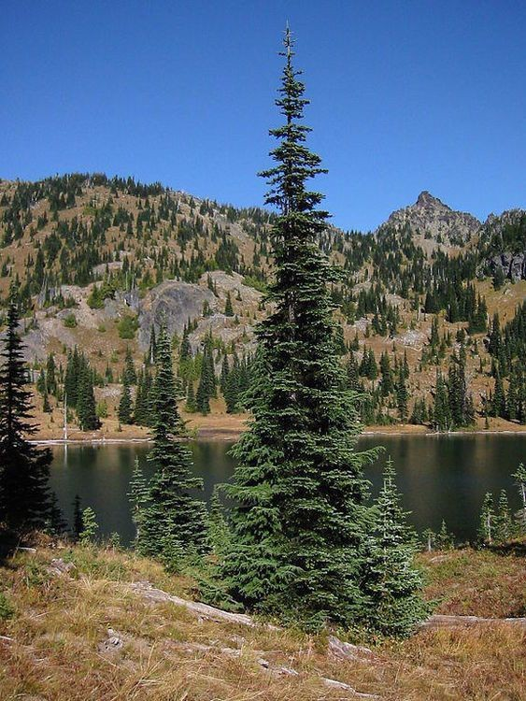
ENGLISH NAME: HIMALIYAN SILVER FIR LOCAL NAME: ROYEE (SHINA), BUDLOO(KASHMIR) BOTANIVCAL NAME: ABIES PINDROW

Slide 3
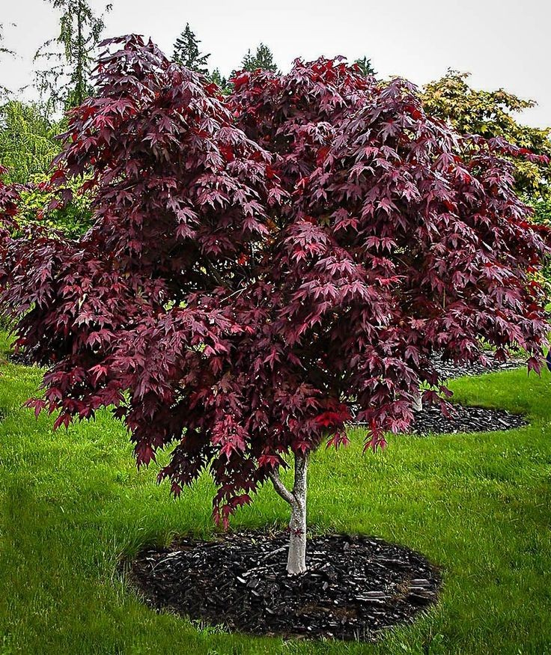
ENGLISH NAME: MAPLE LOCAL NAME: CHAIND, KAANSHIP (SHINA) BOTANIVCAL NAME: ACER CAESIUM

Slide 4
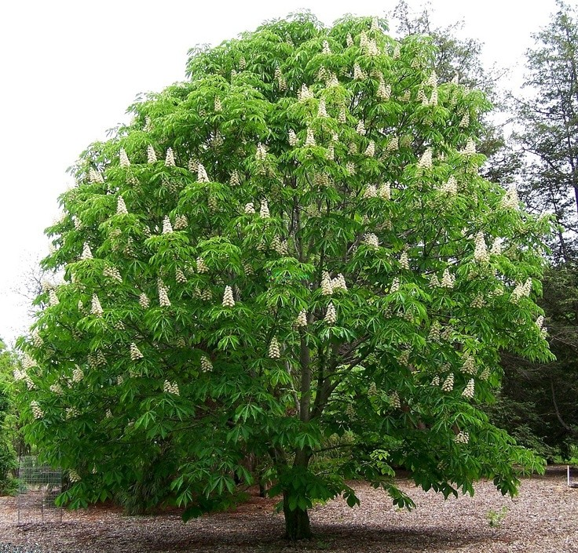
ENGLISH NAME: INDIAN HORSE CHESTNUT LOCAL NAME: HANDOON (KASHMIR) BOTANIVCAL NAME: AESCULUS INDICA

Slide 5
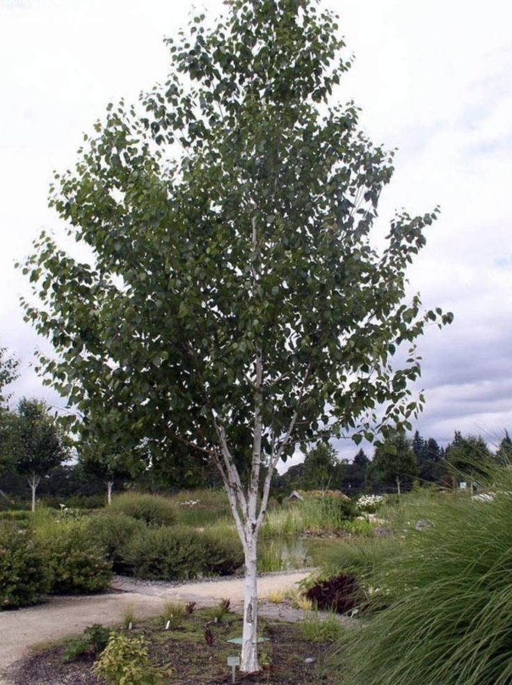
ENGLISH NAME: HIMALIYAN BRICH LOCAL NAME: BURZIL (SHINA) BOTANIVCAL NAME: BETULA UTILIS

Slide 6
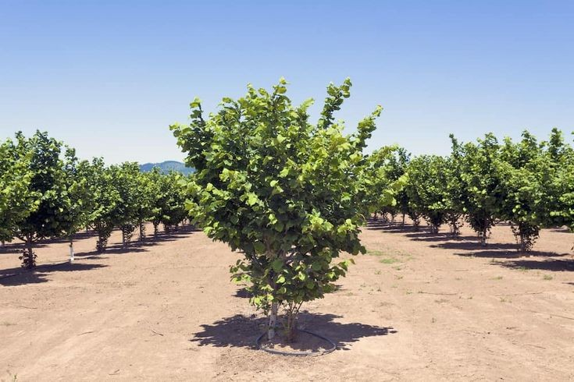
ENGLISH NAME: HIMALAYAN HAZELNUT LOCAL NAME: BAJEERI, SHAHTHORE (SHINA) BOTANIVCAL NAME: CORYLUS FEROX

Slide 7
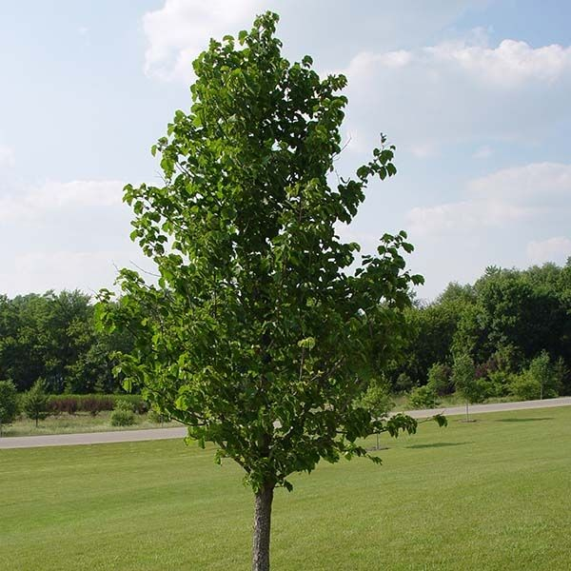
ENGLISH NAME: TURKISH HAZELNUT LOCAL NAME: BAJEERI, SHAHTHORE (SHINA) BOTANIVCAL NAME:CORYLUS JACQUEMONTII

Slide 8
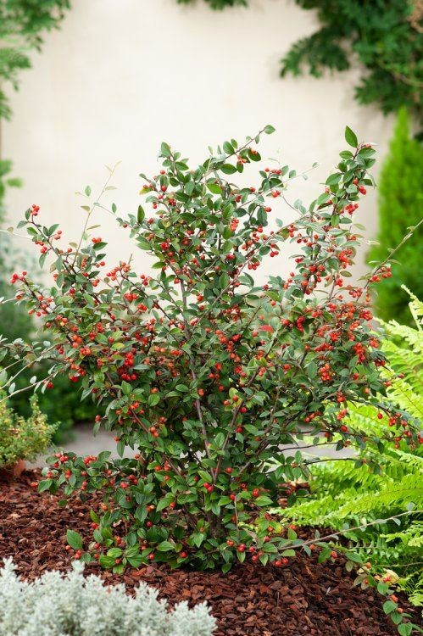
ENGLISH NAME: OPEN FRUITED COTONEASTER LOCAL NAME: RHANSH (SHINA) BOTANIVCAL NAME: COTONEASTER BACILLARIS

Slide 9
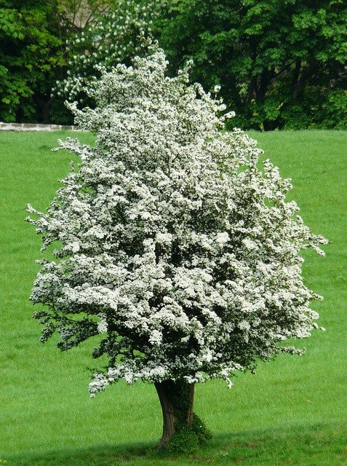
ENGLISH NAME: HOWTHRON LOCAL NAME: RINKUL BOTANIVCAL NAME: CORTAEGUS SONGARICA

Slide 10
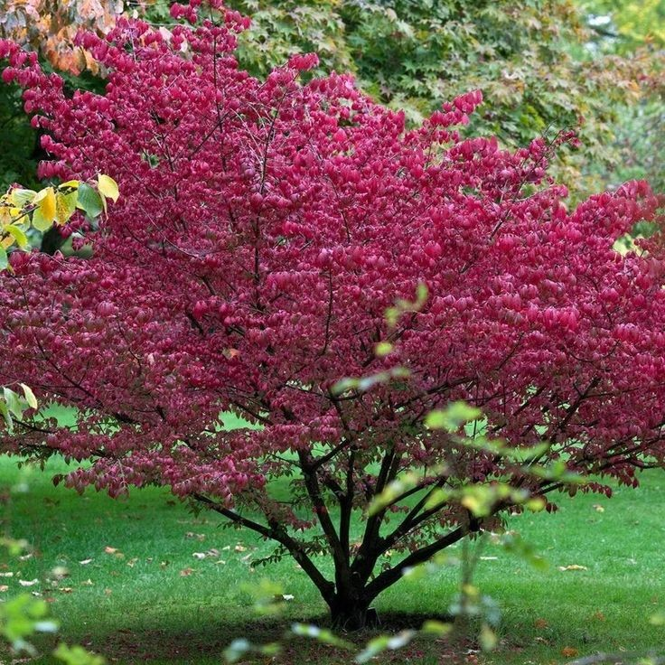
ENGLISH NAME: SPINDLE TREE LOCAL NAME: CHHOL, CHHUL (PAHADI) BOTANIVCAL NAME: EUONYMOUS HAMILTONLANUS

Slide 11
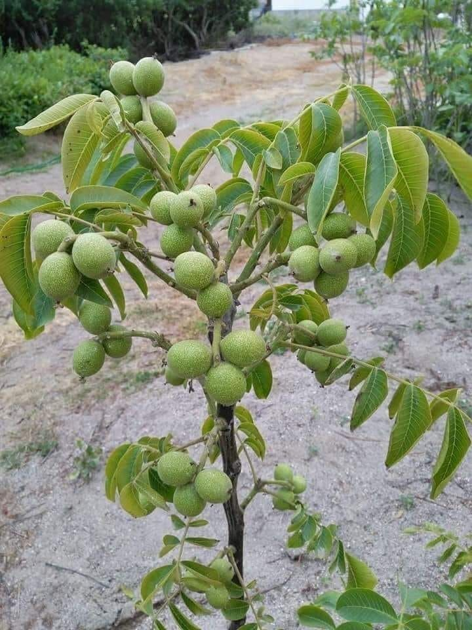
ENGLISH NAME: HIMALAYN WALL NUT, OIL NUT TREE LOCAL NAME: ACHHO BOTANIVCAL NAME: JUGLONS REGIA

Slide 12
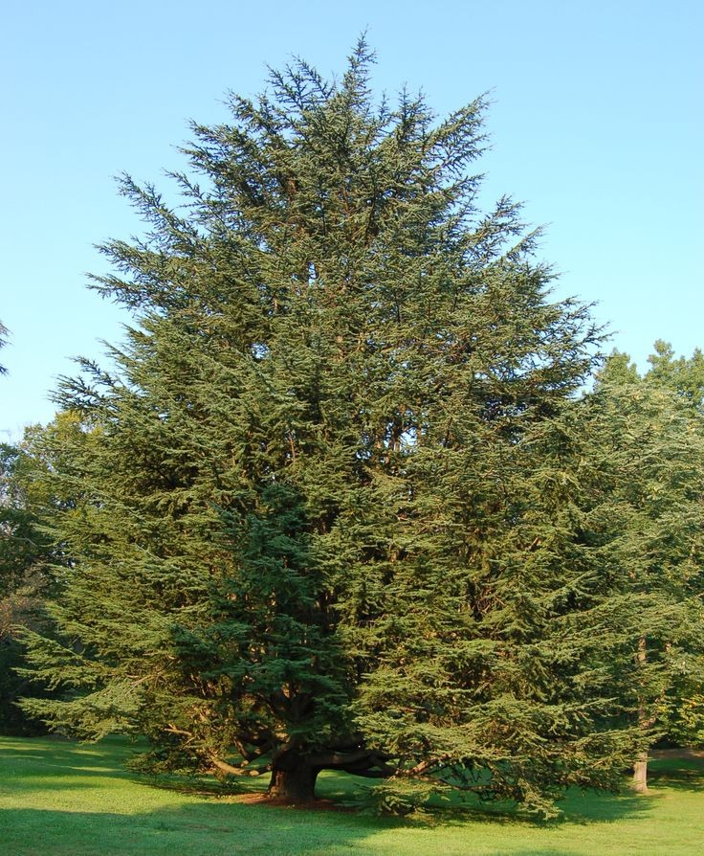
ENGLISH NAME: PENCIL CEDAR LOCAL NAME: PADAM, CHHILLL (SHINA) BOTANIVCAL NAME: EUONYMUS HAMILTONIANUS

Slide 13
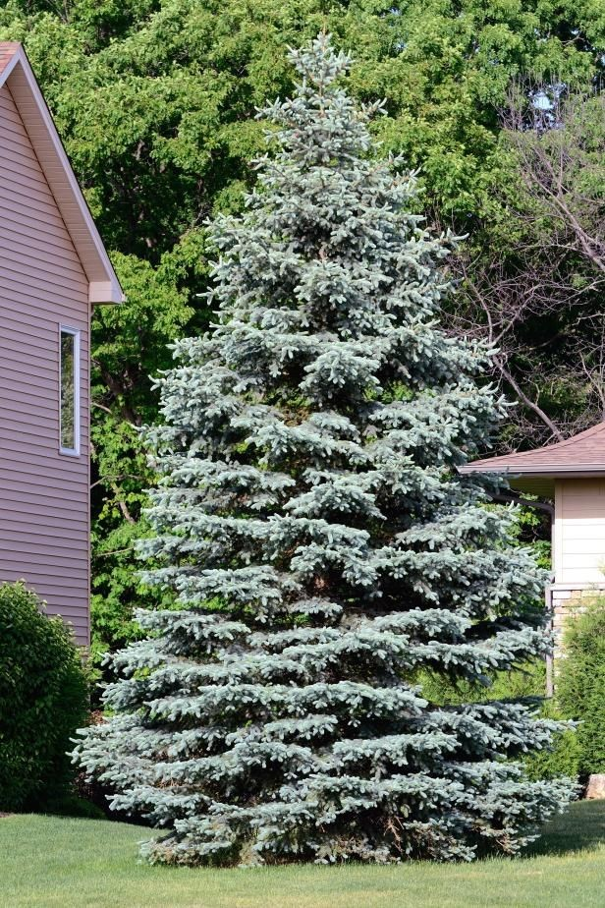
ENGLISH NAME: WEST HIMALAYAN SPRUCE, MIRANDA SPRUCE LOCAL NAME: BOTANIVCAL NAME:

Slide 14
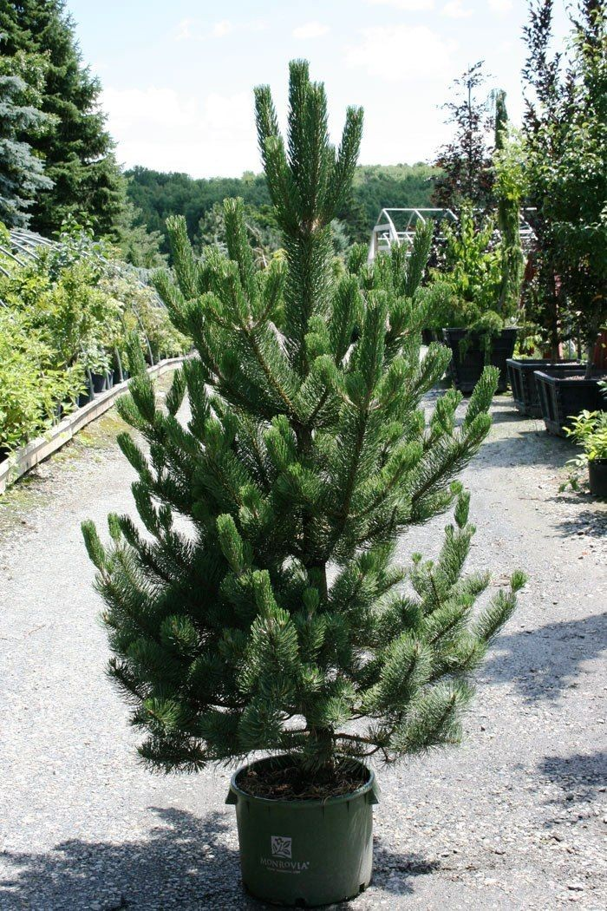
ENGLISH NAME: POPULAS CASPICA BLUE PINE LOCAL NAME: BOTANIVCAL NAME:

Slide 15
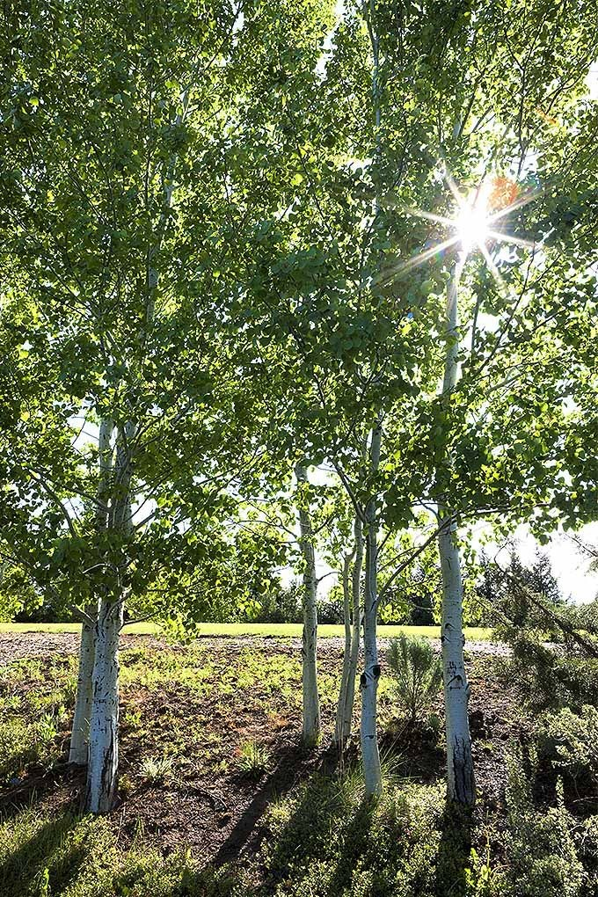
ENGLISH NAME: WHITE POPLAR LOCAL NAME: BOTANIVCAL NAME:

Slide 16
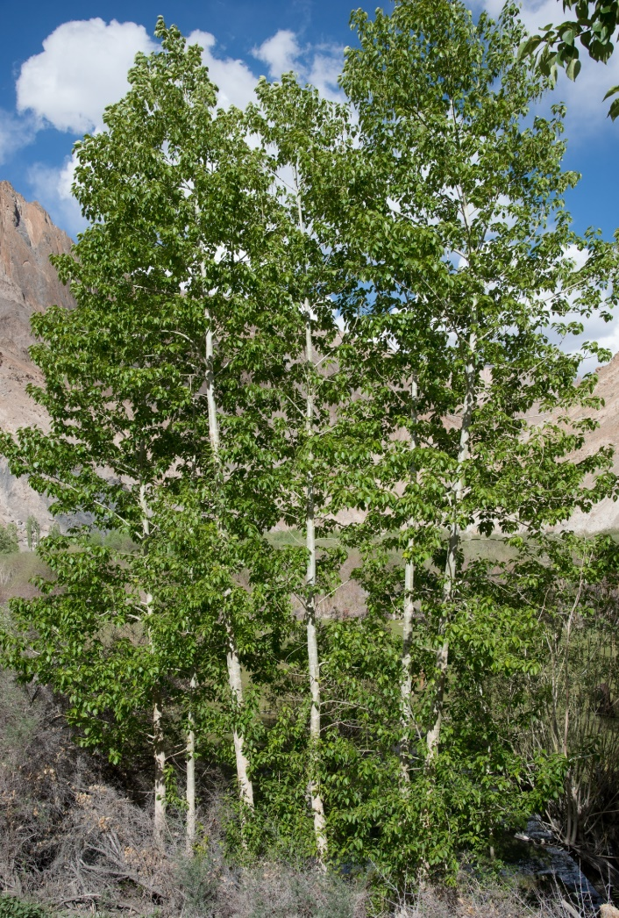
ENGLISH NAME : HIMALAYAN POPLAR LOCAL NAME: BOTANICAL NAME:

Slide 17
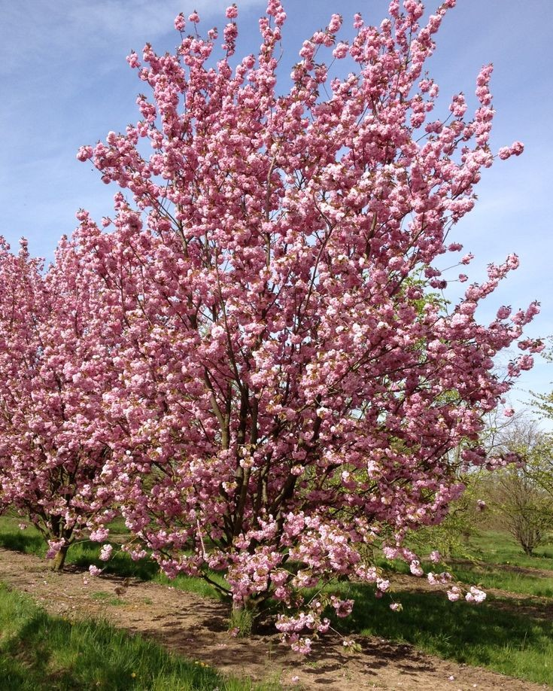
ENGLISH NAME: HIMALAYAN BIRD CHERRY LOCAL NAME: BOTANICAL NAME:

Slide 18
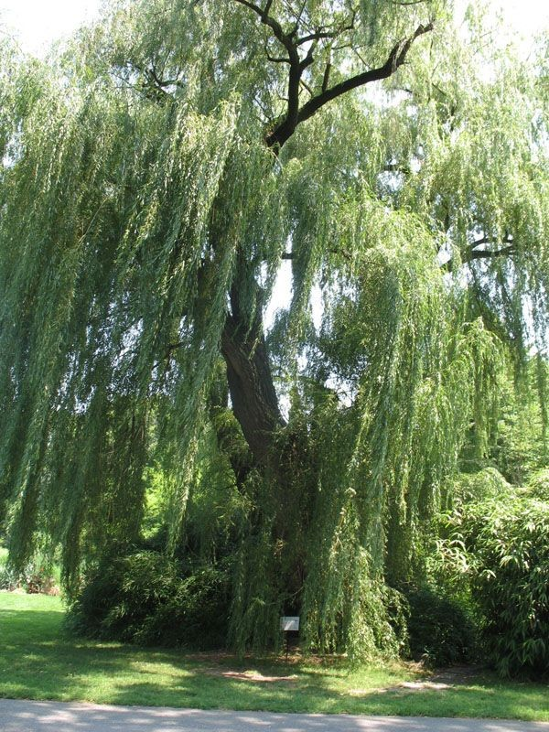
ENGLISH NAME: WHITE WILLOW LOCAL NAME: BOTANICAL NAME:

Slide 19
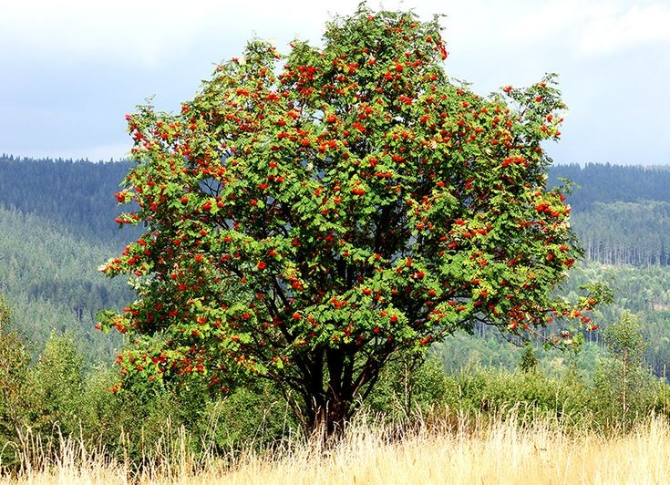
ENGLISH NAME: MOUNTAIN ASH, QUICK BEAM LOCAL NAME: BOTANICAL NAME:

Slide 20
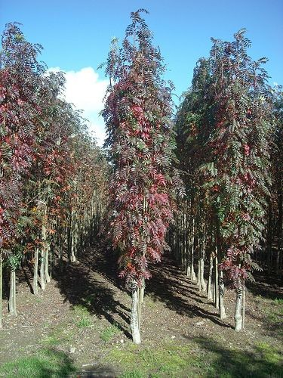
ENGLISH NAME: BEAM TREE LOCAL NAME: BOTANICAL NAME:

Slide 21
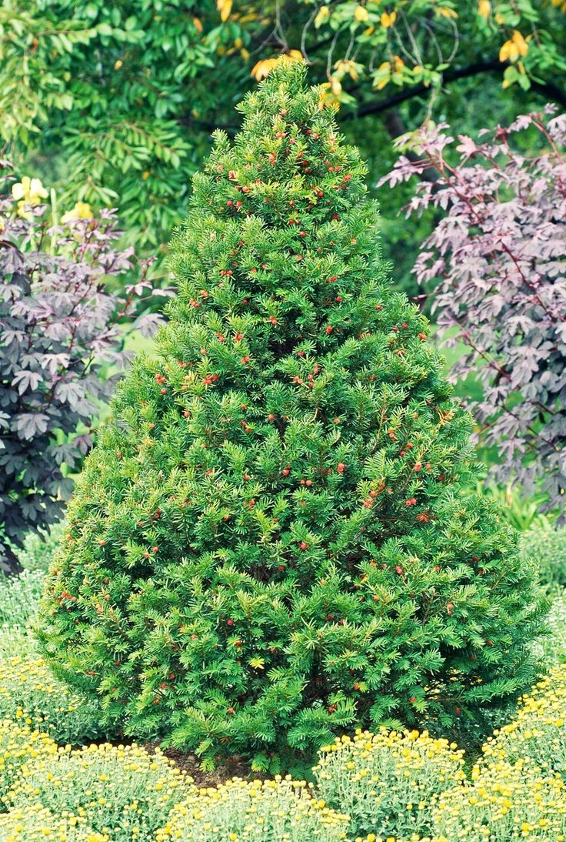
ENGLISH NAME: HIMALAYAN YEW LOCAL NAME: BOTANICAL NAME:

Slide 22
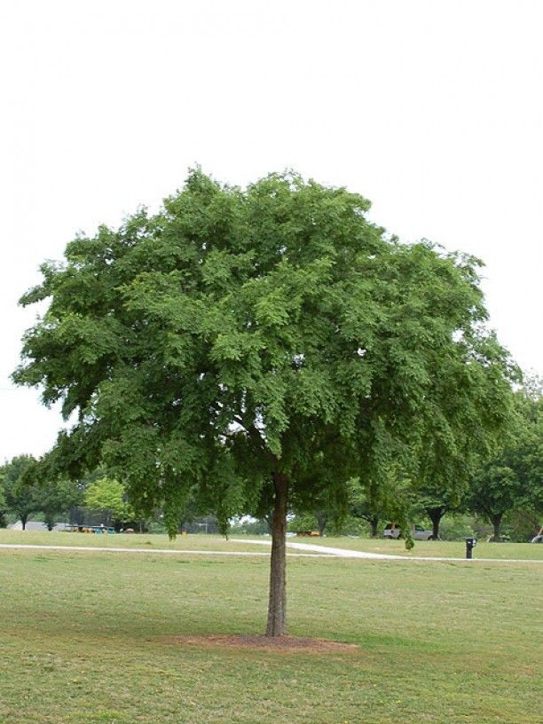
ENGLISH NAME: HIMALAYAN ELM LOCAL NAME: BOTANICAL NAME:

Slide 23
MOUNTAIN SHRUBS

Slide 24
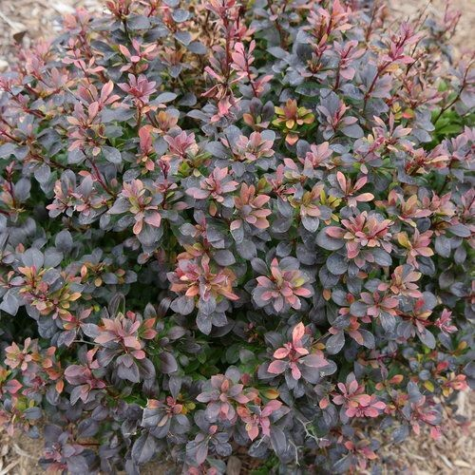
ENGLISH NAME: BARBERRY LOCAL NAME: BOTANICAL NAME:

Slide 25
ENGLISH NAME: COTONEASTER LOCAL NAME: BOTANICAL NAME:

Slide 26
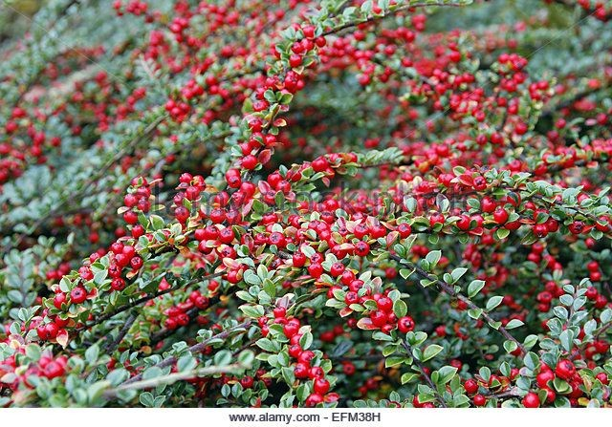
ENGLISH NAME: ROSY COTONEASTER LOCAL NAME: BOTANICAL NAME:

Slide 27
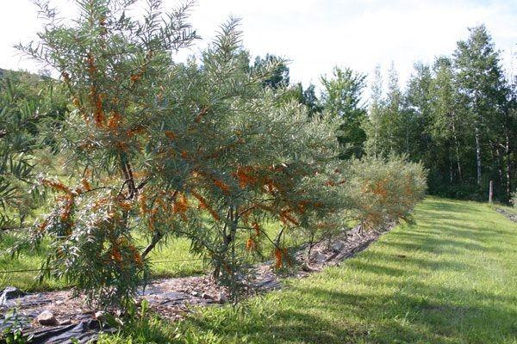
ENGLISH NAME: SEABUCKTHORN LOCAL NAME: BOTANICAL NAME:

Slide 28
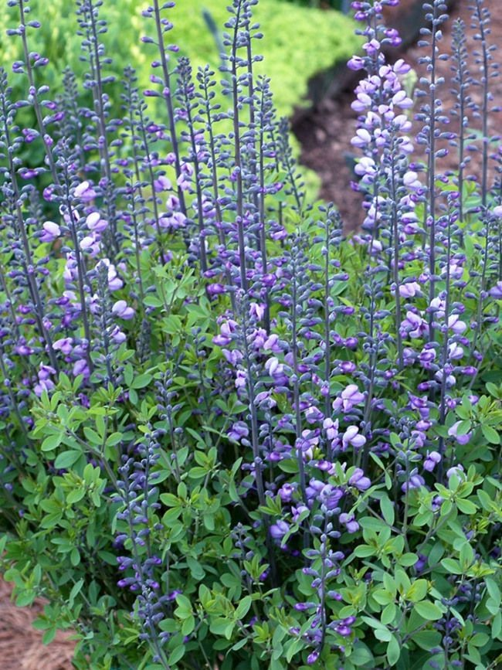
ENGLISH NAME: WILD INDIGO LOCAL NAME: BOTANICAL NAME:

Slide 29
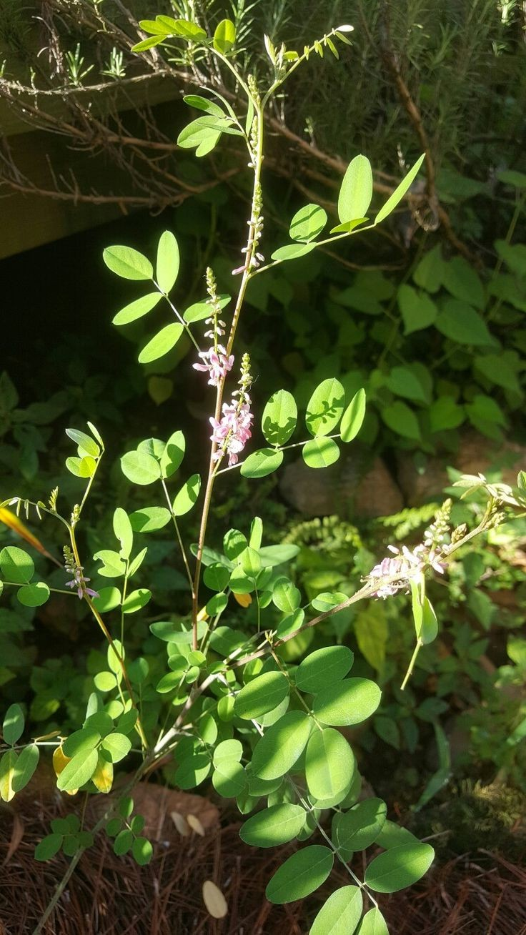
ENGLISH NAME: HIMALAYAN INDIGO LOCAL NAME: BOTANICAL NAME:

Slide 30
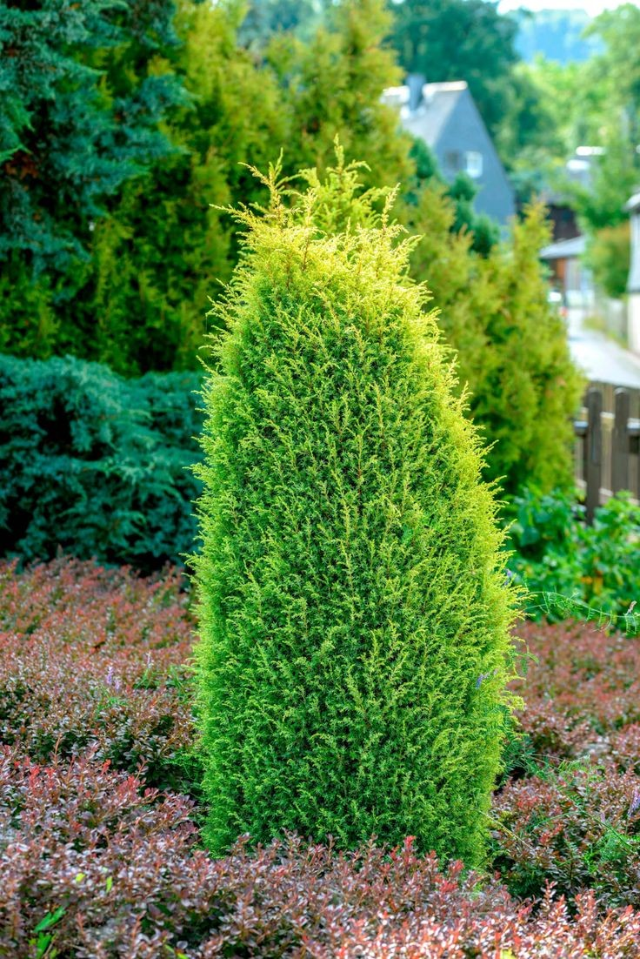
ENGLISH NAME: COMMON JUNIPER LOCAL NAME: BOTANICAL NAME:

Slide 31
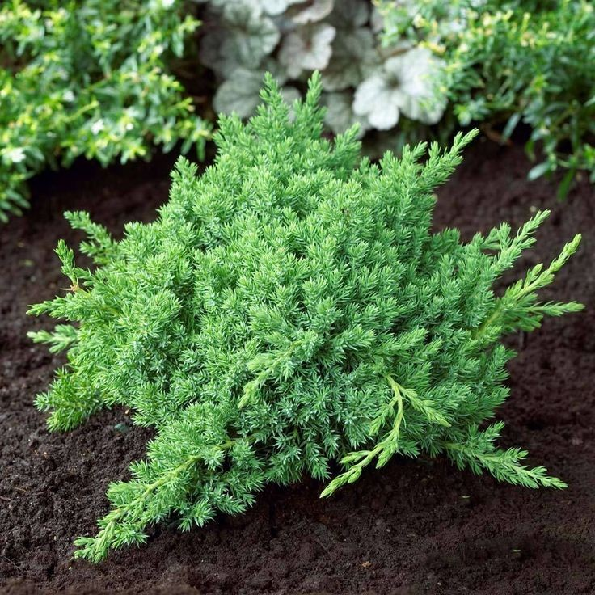
ENGLISH NAME: DROOPING JUNIPER LOCAL NAME: BOTANICAL NAME:

Slide 32
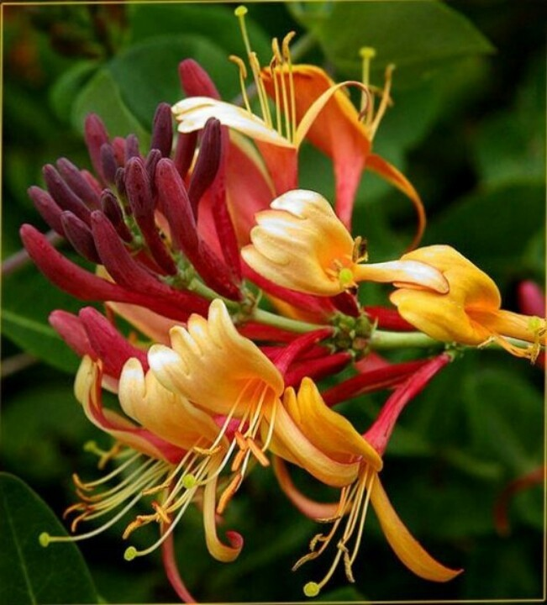
ENGLISH NAME: HONEY SUCKLE LOCAL NAME: BOTANICAL NAME:

Slide 33
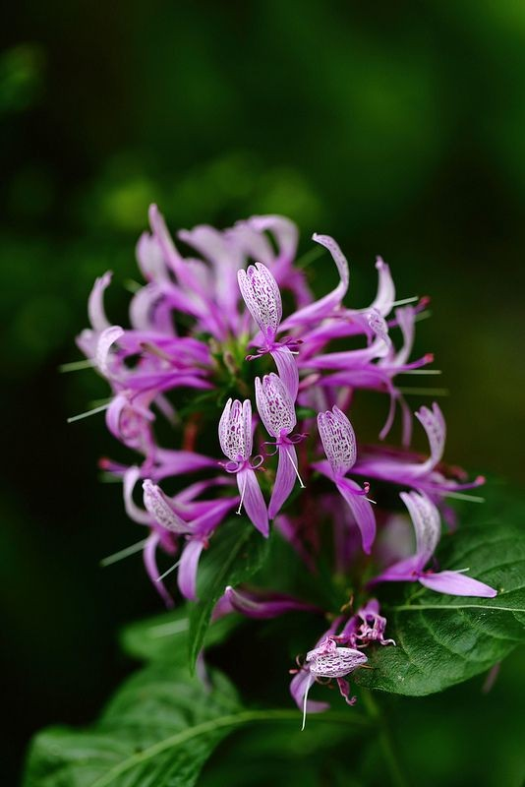
ENGLISH NAME: PURPLE HONEY SUCKLE LOCAL NAME: BOTANICAL NAME:

Slide 34
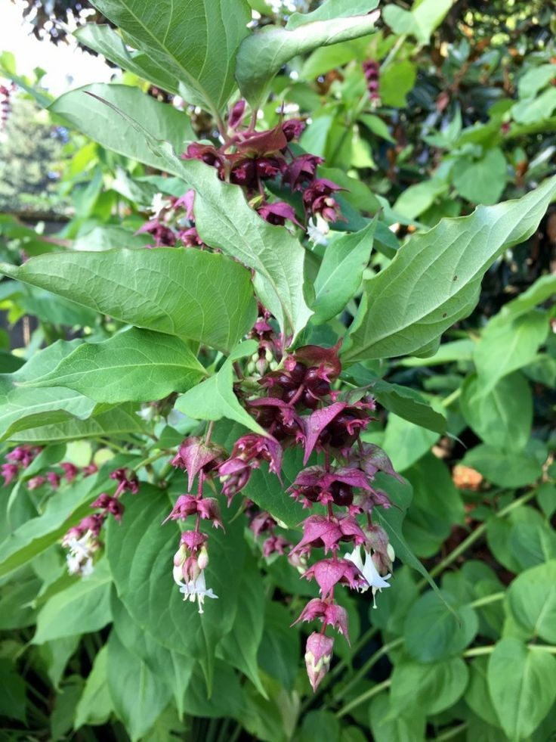
ENGLISH NAME: HIMALAYAN HONEY SUCKLE LOCAL NAME: BOTANICAL NAME:

Slide 35
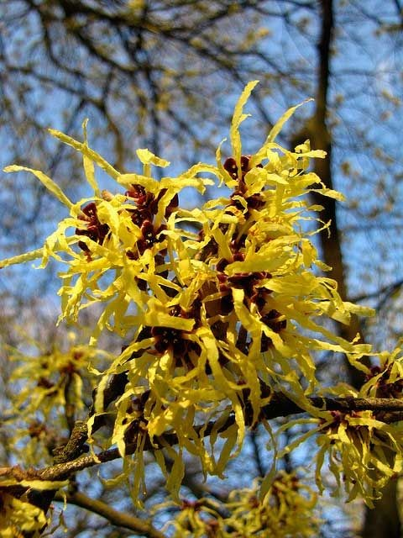
ENGLISH NAME: FALSE WITCH HAZEL LOCAL NAME: BOTANICAL NAME:

Slide 36
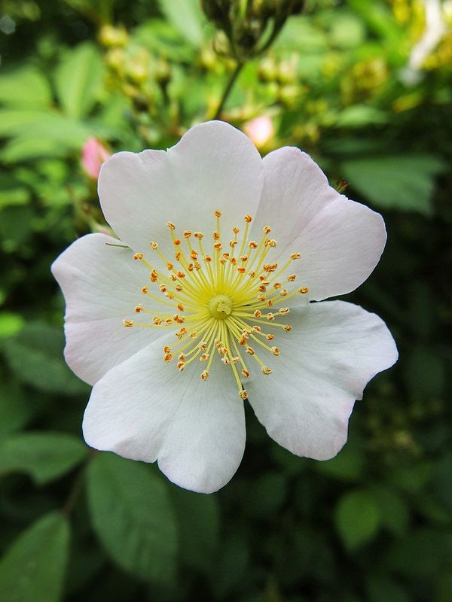
ENGLISH NAME: WHITE WILD ROSE LOCAL NAME: BOTANICAL NAME:

Slide 37
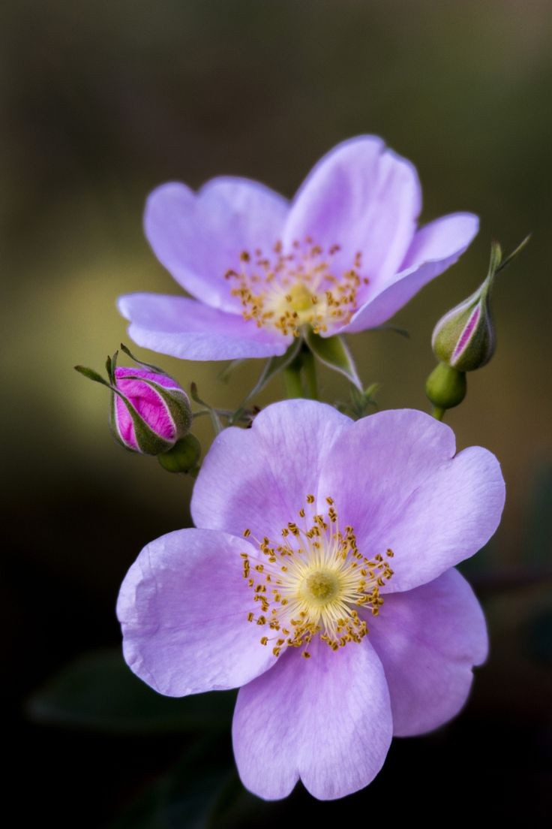
ENGLISH NAME: WILD ROSE LOCAL NAME: BOTANICAL NAME:

Slide 38
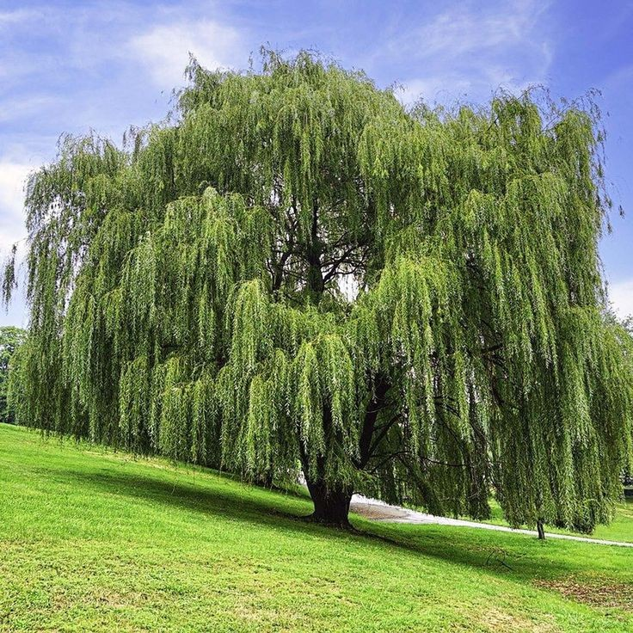
ENGLISH NAME: ELEGANT WILLOW LOCAL NAME: BOTANICAL NAME:

Slide 39
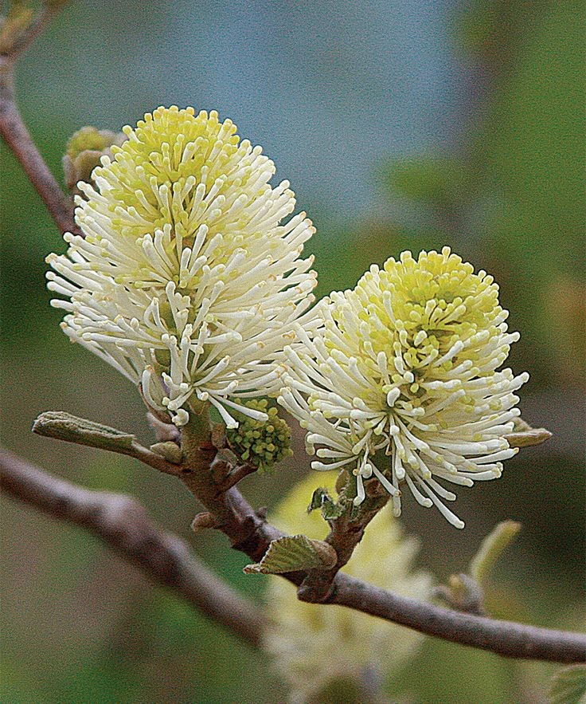
ENGLISH NAME: MUSK DEER LEAF LOCAL NAME: BOTANICAL NAME:

Slide 40
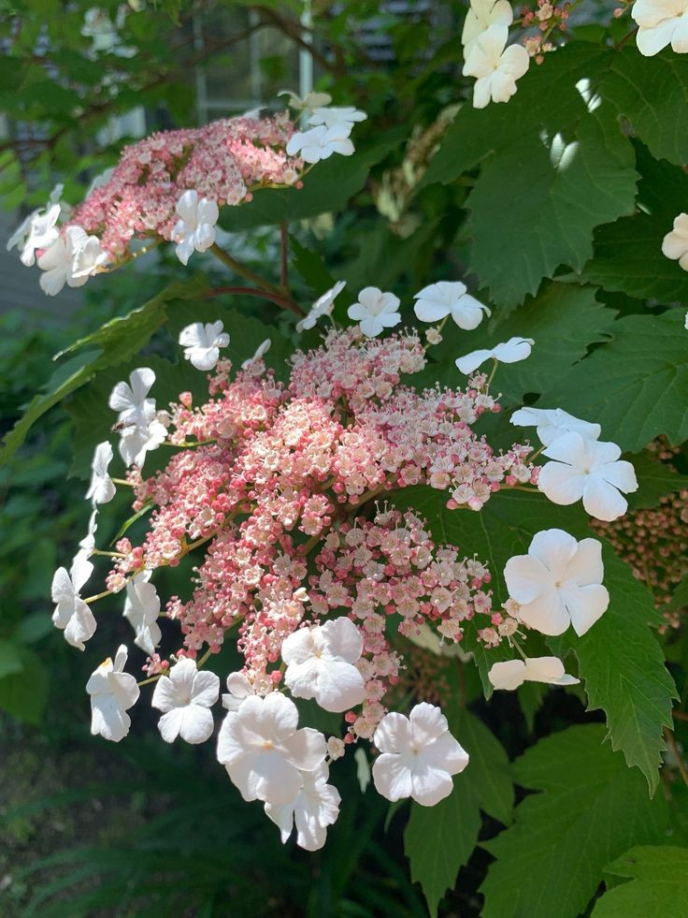
ENGLISH NAME: FRAGRANT FLOWERING LOCAL NAME: BOTANICAL NAME:

Slide 41
MEDICINAL HERBS

Slide 42
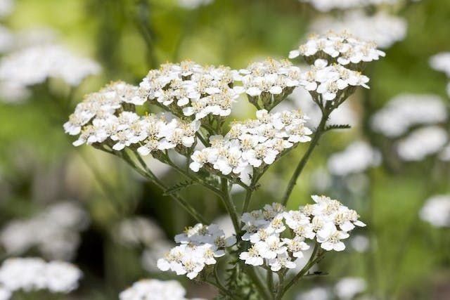
ENGLISH NAME: YARROW , MILFOIL LOCAL NAME: BOTANICAL NAME:

Slide 43
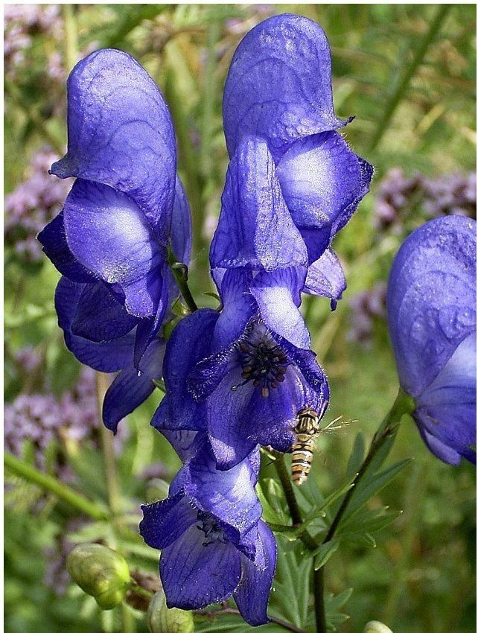
ENGLISH NAME: ACONITE LOCAL NAME: BOTANICAL NAME:

Slide 44
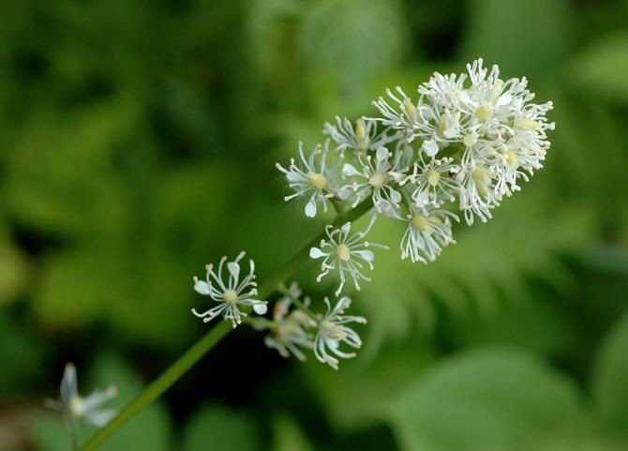
ENGLISH NAME: CHRISTOPHER’S HERB LOCAL NAME: BOTANICAL NAME:

Slide 45
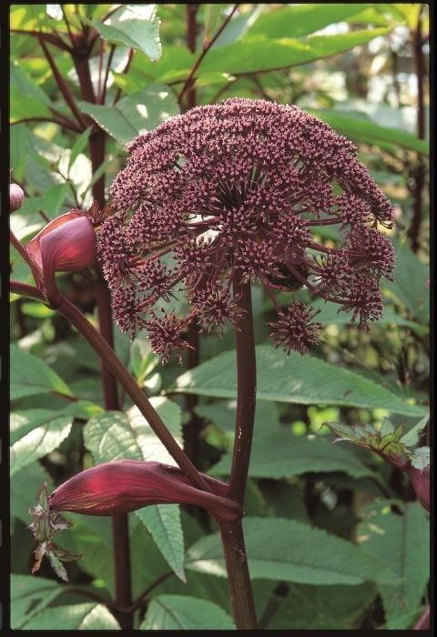
ENGLISH NAME: PURPLE ANGELICA LOCAL NAME: BOTANICAL NAME:

Slide 46
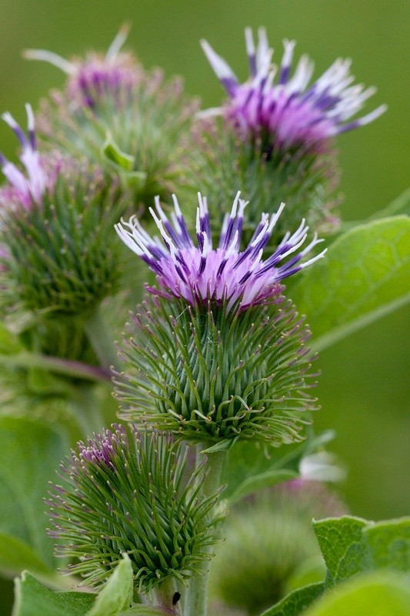
ENGLISH NAME: GREAT BURDOCK LOCAL NAME: BOTANICAL NAME:

Slide 47
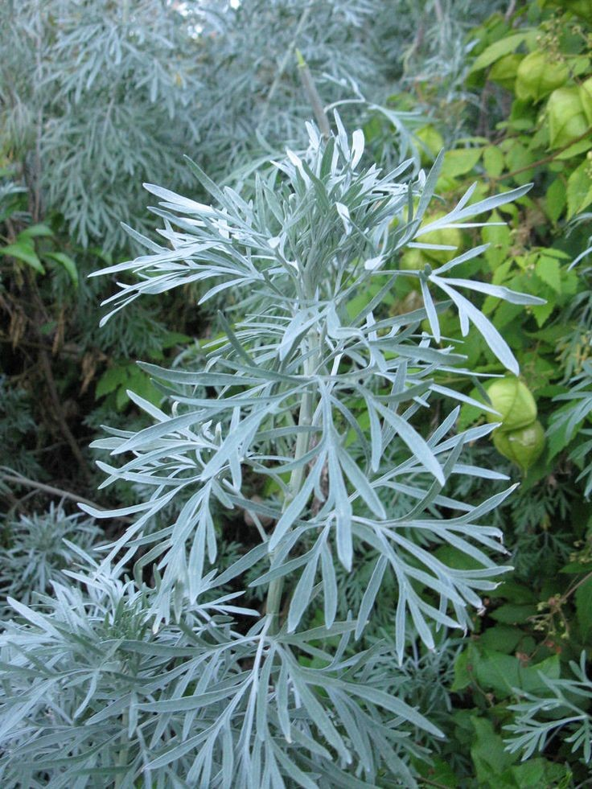
ENGLISH NAME: ABSINTH WORM WOOD LOCAL NAME: BOTANICAL NAME:

Slide 48
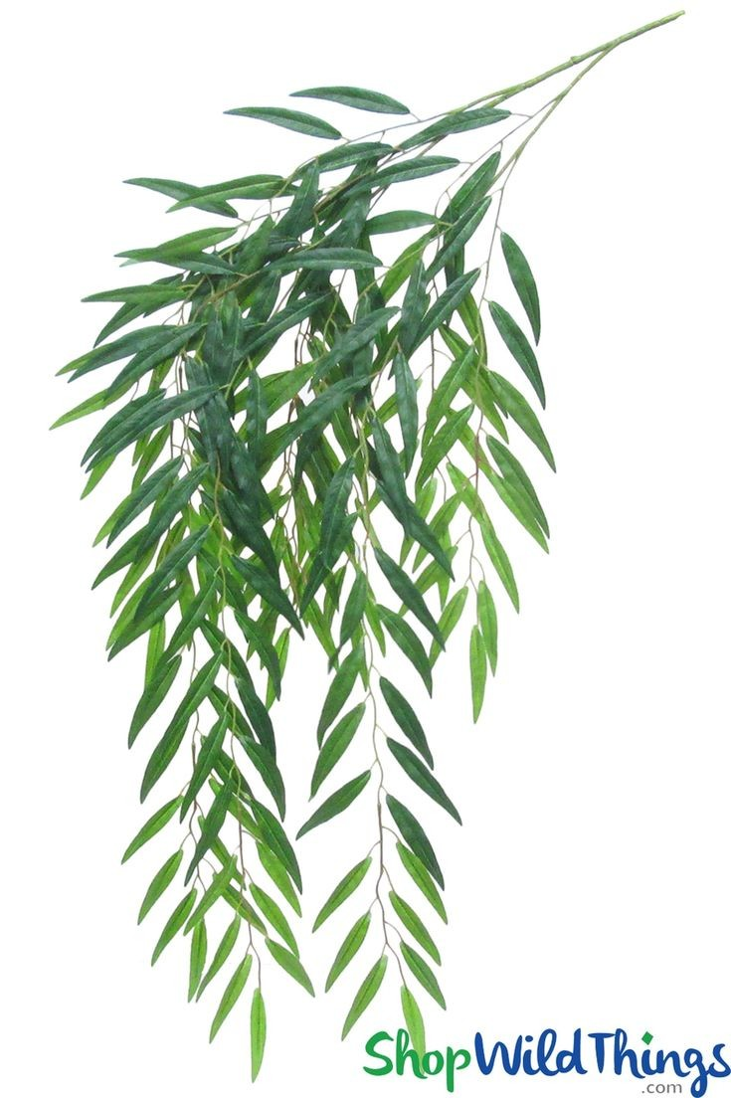
ENGLISH NAME: WILLOW LEAVED WORM WOOD LOCAL NAME: BOTANICAL NAME:

Slide 49
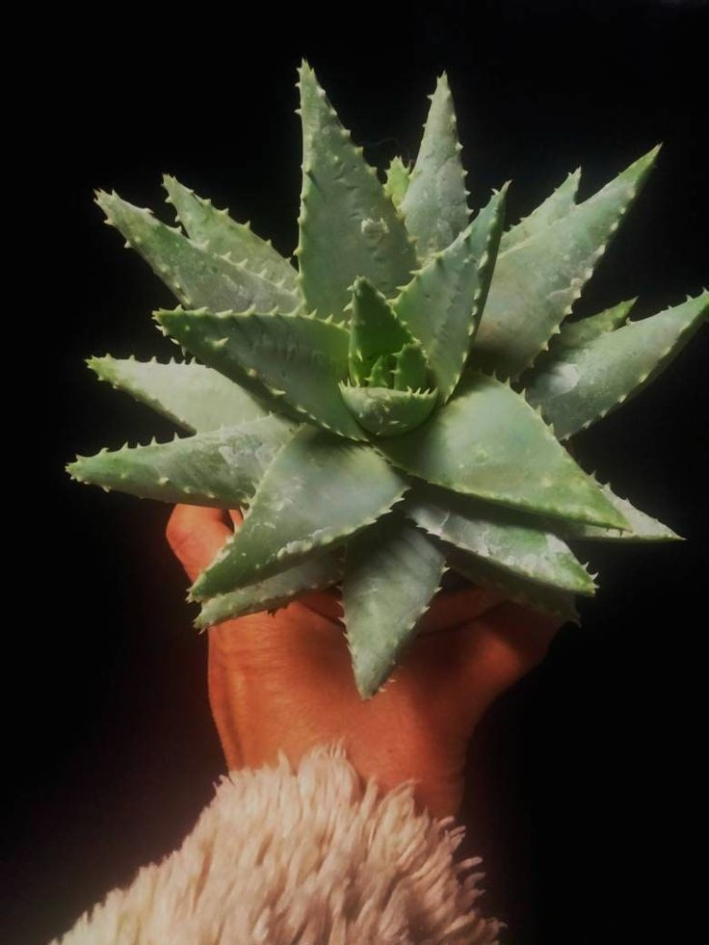
ENGLISH NAME: SILVER WORM WOOD LOCAL NAME: BOTANICAL NAME:

Slide 50
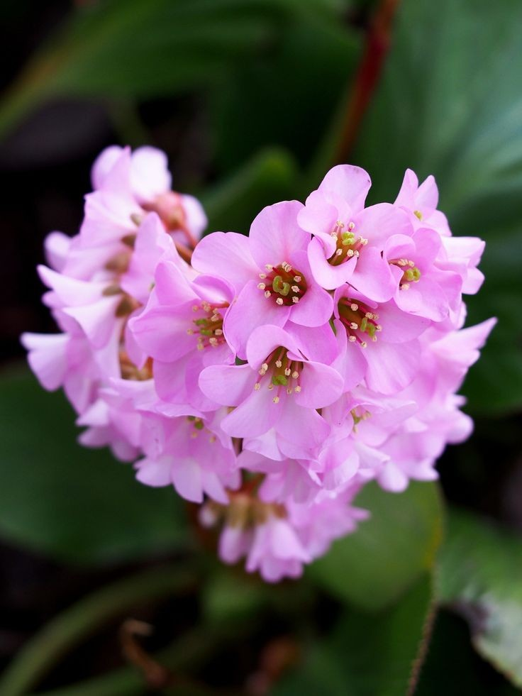
ENGLISH NAME: ROCK SPLITTER LOCAL NAME: BOTANICAL NAME:

Slide 51
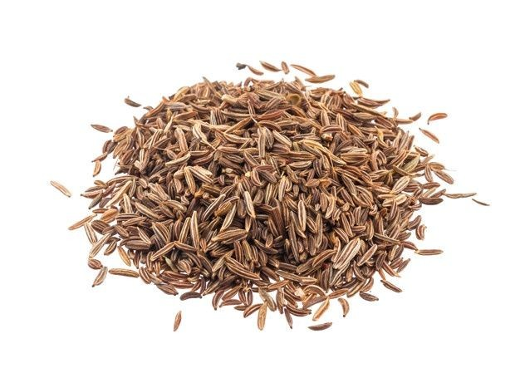
ENGLISH NAME: CARAWAY LOCAL NAME: BOTANICAL NAME:

Slide 52
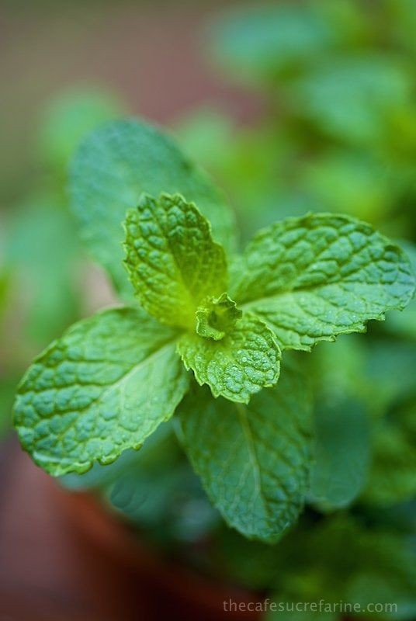
ENGLISH NAME: MINT BASIL LOCAL NAME: BOTANICAL NAME:

Slide 53
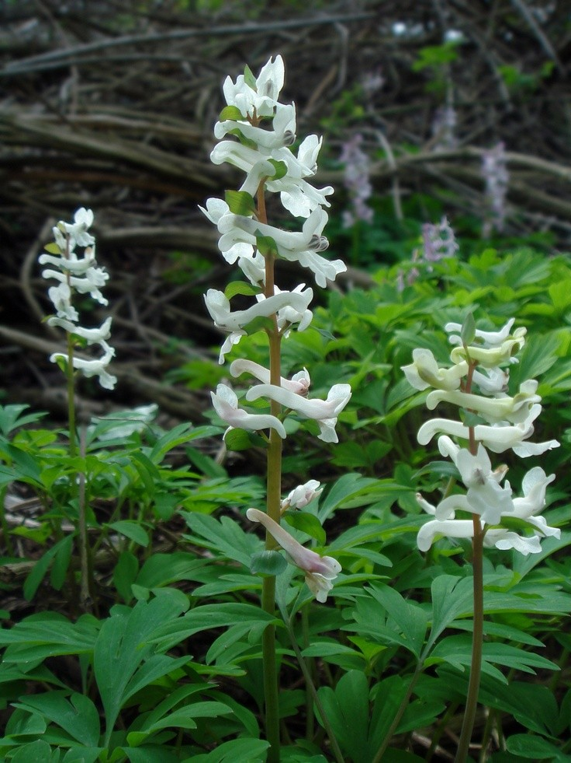
ENGLISH NAME: GOVAN’S FUMATORY LOCAL NAME: BOTANICAL NAME:

Slide 54
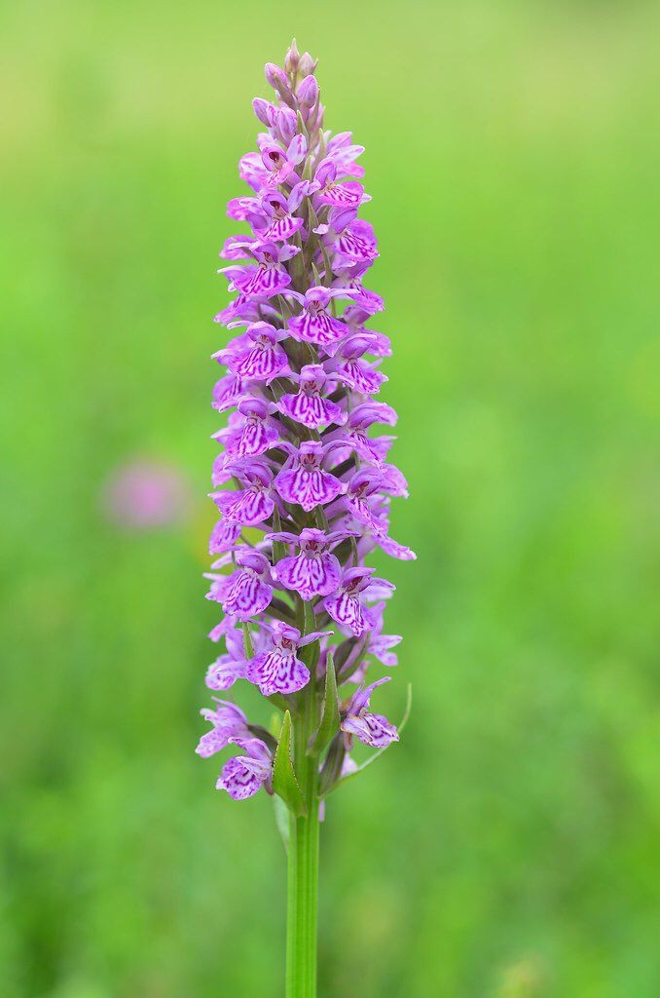
ENGLISH NAME: MARSH ORCHID, PALM ORCHID LOCAL NAME: BOTANICAL NAME:

Slide 55

ENGLISH NAME: BITTER YAM LOCAL NAME: BOTANICAL NAME:

Slide 56

ENGLISH NAME: MEDICAL YAM LOCAL NAME: BOTANICAL NAME:

Slide 57

ENGLISH NAME: LILLY LOCAL NAME: BOTANICAL NAME:

Slide 58

ENGLISH NAME: COW’S PARSNIP, HOGWEED LOCAL NAME: BOTANICAL NAME:

Slide 59

ENGLISH NAME: COMMON HOP LOCAL NAME: BOTANICAL NAME:

Slide 60

ENGLISH NAME: HENBANE, HENBELL LOCAL NAME: BOTANICAL NAME:

Slide 61

ENGLISH NAME: ST. KOHN WORT, ROSIN ROSE LOCAL NAME: BOTANICAL NAME:

Slide 62

ENGLISH NAME: HIMALAYAN BLUE POPPY LOCAL NAME: BOTANICAL NAME:

Slide 63

ENGLISH NAME: MARJORORAM LOCAL NAME: BOTANICAL NAME:

Slide 64

ENGLISH NAME: PLANTAIN, RILOWORT LOCAL NAME: BOTANICAL NAME:

Slide 65

ENGLISH NAME: MAY APPLE, WILD MANDANE LOCAL NAME: BOTANICAL NAME:

Slide 66

ENGLISH NAME: JOCOB’S LADDER, GREEK VALERIAN LOCAL NAME: BOTANICAL NAME:

Slide 67

SOLOMON’S SEAL LOCAL NAME: BOTANICAL NAME:

Slide 68

ENGLISH NAME: HUNTER‘S TEA, KNOTGRASS LOCAL NAME: BOTANICAL NAME:

Slide 69

ENGLISH NAME: PRANGOS FENNEL LOCAL NAME: BOTANICAL NAME:

Slide 70

ENGLISH NAME: SCENTED SAW-WORT, COSTUS ROOT LOCAL NAME: BOTANICAL NAME:

Slide 71

ENGLISH NAME: FIGWORT LOCAL NAME: CHHUST (SHINA) BOTANICAL NAME: SCROPHULARIA POLYANTHA

Slide 72

ENGLISH NAME: MEADOW RUE LOCAL NAME: MAMARI (DOGRI) BOTANICAL NAME: THALICTRUM FOLIOLOSUM

Slide 73

ENGLISH NAME: WILD THYME LOCAL NAME: TUMORO, JAVIND (KASHMIR) BOTANICAL NAME: THYMUS LINEARIS

Slide 74

ENGLISH NAME: TRINITY FLOWER LOCAL NAME: LAIDI (SHINA) BOTANICAL NAME: TRILLIUM GOVANIANA

Slide 75

ENGLISH NAME: ADAM’S FLANNEL LOCAL NAME:RUMKANTH, BUDARKATH(SHINA) BOTANICAL NAME: VERBASCUM THAPSUS

Slide 76

ENGLISH NAME: VIOLET LOCAL NAME: LILLIO (SHINA) BOTANICAL NAME: VIOLA SYNLVATICA

